Slide 1

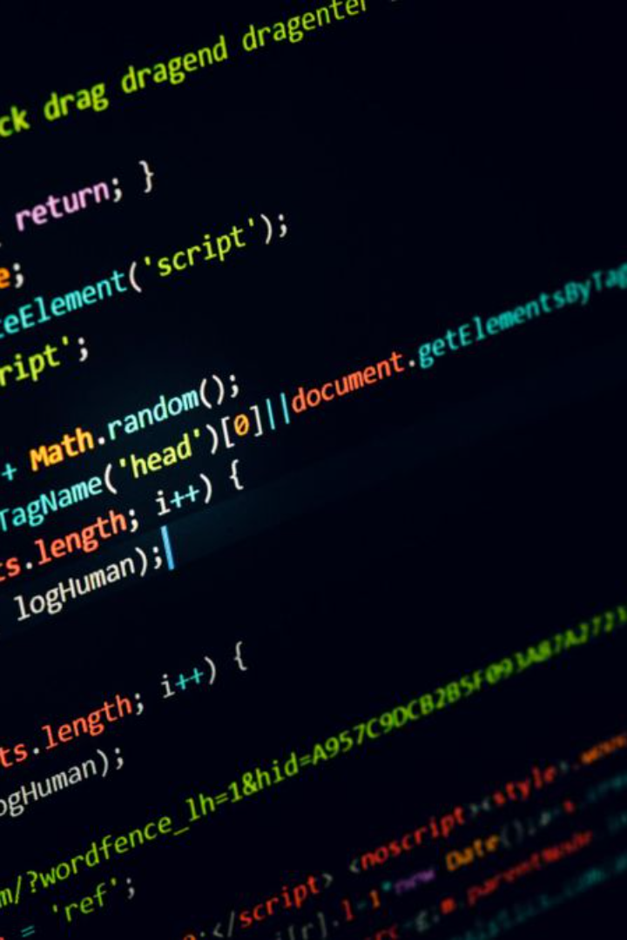
Introduction to Python for Machine Learning
Python is a powerful and versatile programming language, widely used in the field of machine learning. With its clear and concise syntax, Python is an ideal choice for beginners diving into the world of data science and artificial intelligence. This section will provide a comprehensive overview of Python's applications in machine learning, covering fundamental concepts and practical examples.
Ma
by Mvurya Mgala

Slide 2
What is Python?
High-Level Language
Versatility
Rich Ecosystem
Python is a high-level programming language known for its readability and simplicity. It allows programmers to express concepts in fewer lines of code compared to other languages, making it a popular choice for beginners and experts alike.
Python is widely used for various applications such as web development, data analysis, artificial intelligence, and scientific computing. Its versatility makes it a go-to language for a wide range of projects and industries.
The Python ecosystem includes a vast collection of libraries and frameworks, such as NumPy, TensorFlow, and Django, providing extensive support for different programming needs and making it a strong choice for machine learning projects.

Slide 3
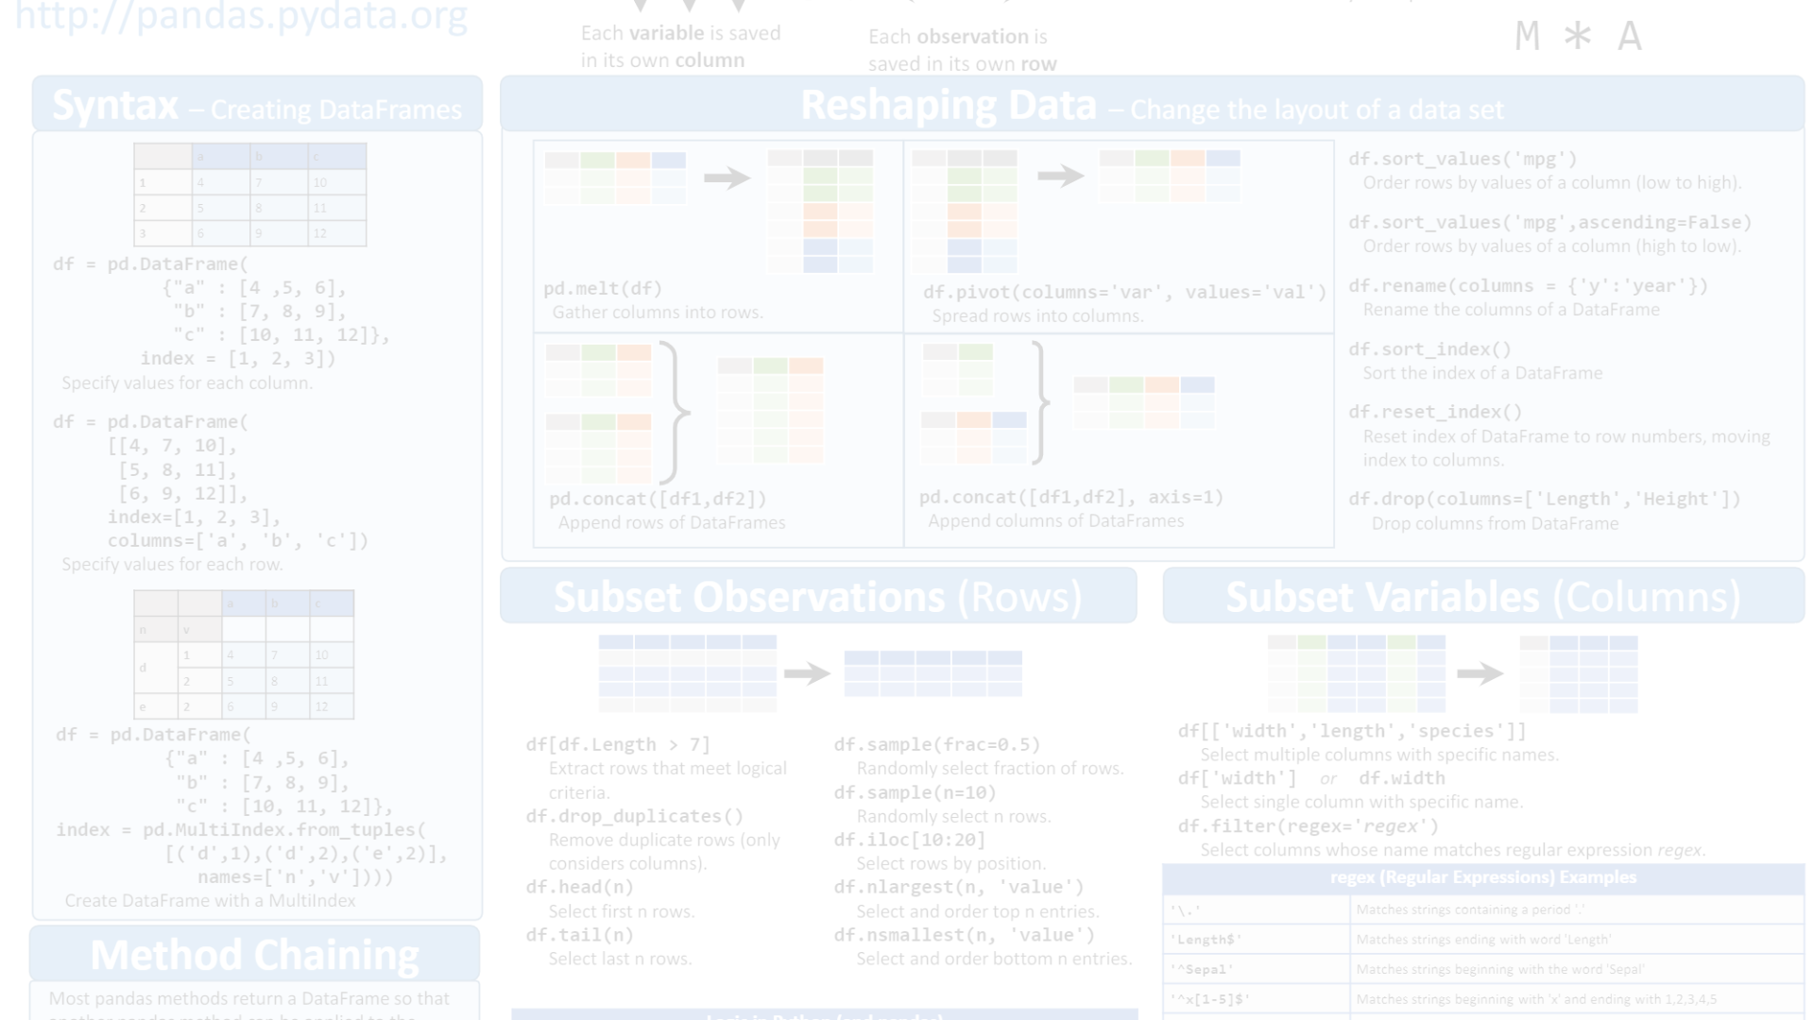
Why Python for machine learning?
Easy to Learn: Python's simple syntax and readability make it easy for beginners to grasp the language, allowing for a smooth transition into machine learning.
Versatile Libraries: Python offers powerful libraries like TensorFlow, Keras, and scikit-learn, which provide robust tools for data analysis, visualization, and model training.
Community Support: The extensive Python community and ecosystem provide access to a wide range of resources, forums, and documentation, making it easier to troubleshoot and learn from others' experiences.

Slide 4
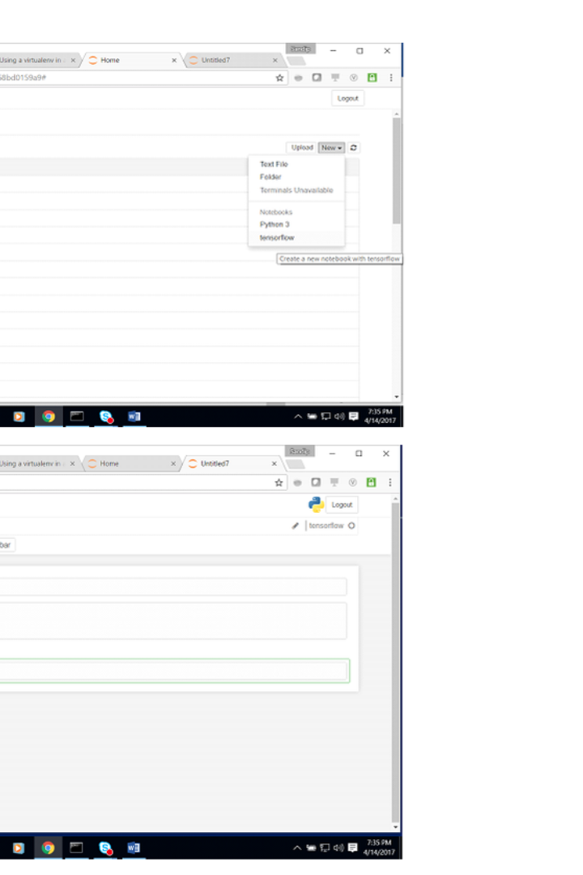
Installing Python
Python is a versatile and powerful programming language that is widely used in various fields, including machine learning and data science. In this section, we will explore the process of installing Python, which is the first step towards diving into the world of programming and software development.

Slide 5
Setting up the Development Environment
Python Installation
Integrated Development Environment (IDE)
Before diving into programming foundations, it is crucial to have Python, the primary language for machine learning, installed on your system. There are various ways to install Python, including the official Python website or using package managers like Anaconda.
Choosing the right IDE is essential for an efficient and productive programming experience. IDEs like PyCharm, Jupyter Notebook, or Visual Studio Code offer features such as code completion, debugging, and project management tailored for Python development.
Python Libraries
Virtual Environments
Understanding the essential Python libraries for machine learning, such as NumPy, Pandas, and Matplotlib, is vital. These libraries provide powerful tools for data manipulation, visualization, and scientific computing, laying the groundwork for machine learning applications.
Creating isolated Python environments using tools like virtualenv or conda helps manage dependencies and package versions effectively. This practice ensures project reproducibility and prevents version conflicts, crucial for machine learning projects.

Slide 6

Python Basics
Python is an incredibly powerful and versatile programming language that is commonly used in machine learning and data science. In this section, we will cover the fundamental concepts and syntax of Python, providing a solid foundation for further exploration of the language.

Slide 7
Variables and Data Types
Integer: Variables that store whole numbers, such as 10, -5, or 0
String: Data type used to store text, like "Hello, World!" or "Python"
Boolean: Data type that can only have two values, True or False
Float: Variables that store decimal numbers, like 3.14 or -0.001
List: A data structure to store a collection of items, such as [1, 2, 3] or ['apple', 'banana', 'cherry']

Slide 8
Operators and Expressions
Arithmetic Operators: These include addition, subtraction, multiplication, division, and modulus. They are used to perform mathematical calculations in Python.
Comparison Operators: These are used to compare two values and result in a boolean value (True or False), such as equal to, not equal to, greater than, less than, etc.
Logical Operators: These include AND, OR, and NOT and are used to combine conditional statements.
Bitwise Operators: These operators work on bits and perform bit by bit operation. They are used in binary numbers and can be quite powerful for specific operations.

Slide 9
Control flow statements
If statement: Allows the program to execute a certain block of code only if a specified condition is true.
For loop: A control flow statement for specifying iteration, executing a block of code repeatedly.
While loop: Executes a block of code as long as the specified condition is true.
Switch statement: A control flow statement that checks a variable against a list of values and executes a block of code based on the matching value.

Slide 10
Conditional Statements in Python
What are conditional statements? Conditional statements in Python are used to execute a block of code based on a condition. They allow the program to make decisions and perform different actions based on different conditions.
Types of conditional statements: Python supports if statements, if-else statements, if-elif-else statements, and nested if statements to handle various conditions and scenarios.
Importance in programming: Conditional statements are fundamental to programming and are crucial for creating dynamic and responsive applications. They are especially important in machine learning algorithms and decision-making processes.
Examples: Examples of conditional statements in Python include checking for a certain condition before executing code, handling user input validation, and implementing decision trees in machine learning models.

Slide 11
Looping Statements
For Loop: A fundamental construct in programming, the for loop allows you to iterate over a sequence of elements, such as a list or a range of numbers, and perform a set of operations on each iteration.
While Loop: Another important looping statement, the while loop continues to execute a block of code as long as the specified condition is true. It's ideal for situations where you want to repeat a task an indefinite number of times.
Nested Loops: In more complex scenarios, nested loops provide the ability to have one or more loops inside another loop. This is incredibly useful for iterating through multidimensional arrays or performing matrix operations.
Loop Control Statements: Within Python, loop control statements like break, continue, and pass offer greater control over the flow of execution within loops, allowing for more precise and efficient code.

Slide 12
Functions in Python
Function Definition: In Python, functions are defined using the "def" keyword followed by the function name and parentheses. For example, def my_function():
Parameters and Arguments: Functions can take parameters, which are values passed to the function, and arguments are the actual values. We can also have default parameters and variable-length arguments.
Return Statement: A function can return a value using the "return" statement. If no return statement is specified, the function returns None by default.
Scope of Variables: Understanding the scope of variables is crucial in Python functions. Local, global, and nonlocal variables play a significant role.
Docstrings and Comments: It's best practice to include docstrings to describe the function's purpose and usage. Additionally, using comments within the function can improve code readability.

Slide 13
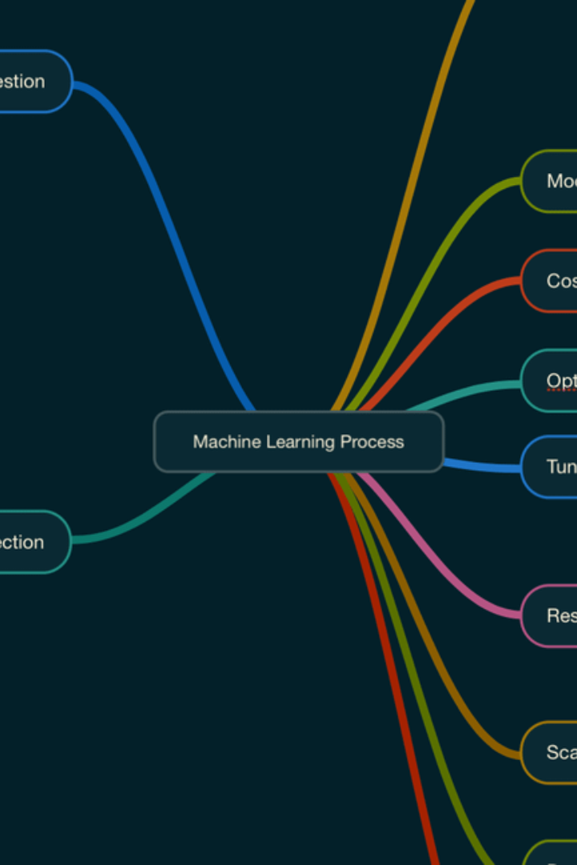
Introduction to Machine Learning
Machine learning is a fascinating and rapidly growing field that involves the design and development of algorithms and models that allow computers to learn from and make predictions or decisions based on data. This intriguing concept has endless applications, from recommendation systems and image recognition to natural language processing and autonomous vehicles.

Slide 14

What is Machine Learning?
Data Analysis
Prediction and Pattern Recognition
At its core, machine learning involves the use of algorithms and statistical models to enable computers to progressively improve their performance on a specific task by learning from data, without being explicitly programmed.
Machine learning enables systems to automatically learn and improve from experience. This includes analyzing patterns in data, making predictions, and continuously improving performance over time.
Applications in Real Life
It has a wide range of applications, from email filtering and recommendation systems to autonomous vehicles and medical diagnosis. These applications all rely on the ability to automatically learn and improve from experience.

Slide 15
Types of Machine Learning Algorithms
Supervised Learning: Algorithms that learn from labeled training data to make predictions or decisions.
Unsupervised Learning: Algorithms used to find hidden patterns or intrinsic structures in input data.
Reinforcement Learning: Learning through trial and error, where an agent learns to make decisions by maximizing rewards.
Deep Learning: A subset of machine learning using artificial neural networks to model high-level abstractions in data.
Machine learning algorithms are categorized into different types based on their learning and decision-making processes. Supervised learning involves the use of labeled data to predict outcomes, while unsupervised learning deals with finding patterns in unlabeled data. Reinforcement learning focuses on learning through interaction with the environment, and deep learning utilizes neural networks for complex pattern recognition. Each type has its own applications and advantages in the field of machine learning.

Slide 16
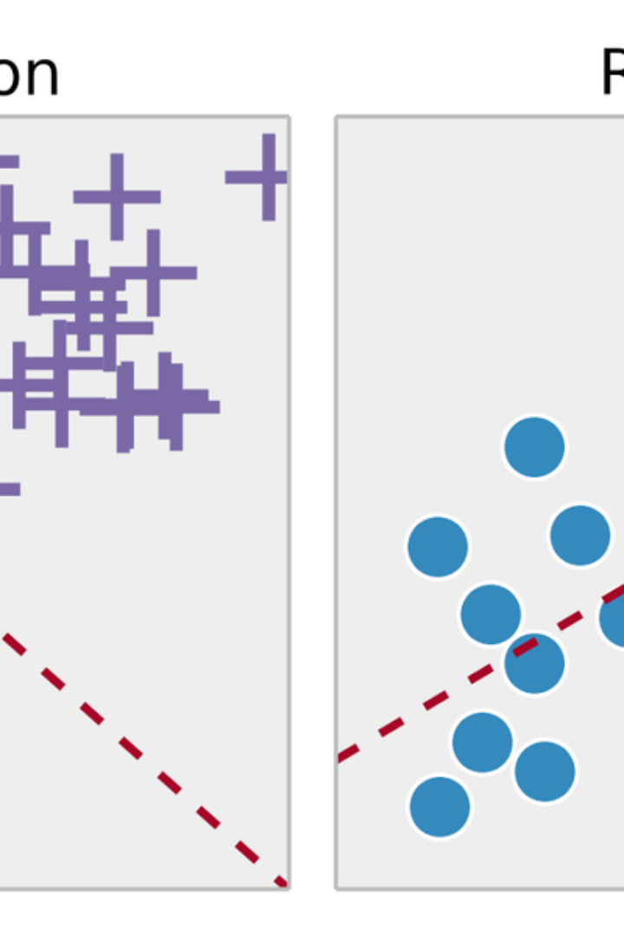
Supervised Learning
Supervised learning is a fundamental concept in machine learning, where the algorithm learns from labeled training data to make predictions or decisions. It is widely used in various applications such as classification, regression, and anomaly detection. In supervised learning, a model is trained on a set of input-output pairs, and the goal is to learn a mapping from inputs to outputs. This enables the model to generalize and make predictions on new, unseen data.

Slide 17
Unsupervised Learning
Unsupervised learning is a machine learning technique used to uncover underlying patterns in data without the need for labeled outcomes.
It involves exploring and identifying hidden structures or relationships within a dataset through various algorithms and statistical methods.
By allowing the model to learn independently from unlabeled data, unsupervised learning is essential for tasks such as clustering, anomaly detection, and dimensionality reduction.
One common example of unsupervised learning is clustering, where data points are grouped based on similarities, leading to insights and valuable information discovery.
Another notable application is in recommendation systems, where unsupervised learning can help identify patterns and similarities among items or users.

Slide 18
Reinforcement learning
Definition: Reinforcement learning is a type of machine learning where an agent learns to make decisions by taking actions within an environment to achieve specific goals.
Elements: It involves the interaction between the agent, environment, actions, rewards, and learning process.
Applications: Reinforcement learning is used in various fields such as robotics, game playing, autonomous vehicles, and recommendation systems.

Slide 19
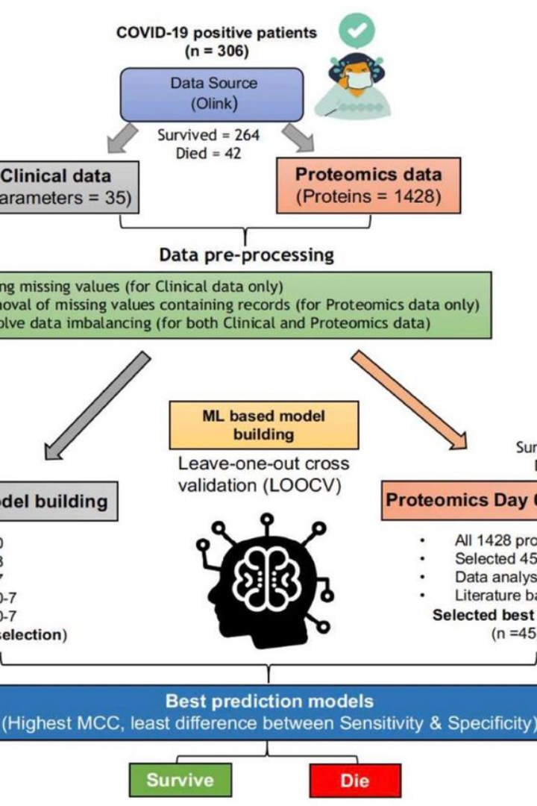
Data preprocessing for machine learning
Effective data preprocessing is crucial for building successful machine learning models. It involves cleaning, transforming, and organizing raw data into a format suitable for analysis and model training. This process includes handling missing values, scaling features, encoding categorical variables, and splitting the dataset into training and testing sets.

Slide 20
Data Cleaning
Remove Duplicates: Identify and eliminate any duplicate or redundant data points to ensure accuracy and consistency.
Handle Missing Values: Utilize appropriate techniques such as imputation or deletion to address missing data points without compromising the integrity of the dataset.
Normalize Data: Standardize the data to a common scale to facilitate effective analysis and comparison.
Outlier Detection: Identify and manage outliers that may adversely affect the statistical analysis and machine learning models.

Slide 21
Data Transformation
Introduction to Python for Machine Learning: Explore the foundational concepts of Python programming specifically tailored for machine learning applications. This lecture covers the essential principles and practices, setting the stage for a deep understanding of Python's role in the machine learning ecosystem.
Python Basics: Delve into the basics of Python, including data types, variables, and control structures, with a focus on their relevance to machine learning development.
Data Manipulation with Python: Learn how Python can be used to transform and manipulate data, a crucial skill in machine learning, including methods for cleaning, formatting, and preparing data for analysis and modeling.
Introduction to Data Visualization: Gain an understanding of data visualization techniques with Python, learning how to represent information graphically for easier interpretation and insight.
Advanced Python Concepts for Machine Learning: Take a deeper dive into more advanced Python concepts that are critical for machine learning, including object-oriented programming, modules, and libraries utilized for machine learning applications.

Slide 22
Feature Scaling
Normalization: Normalization is a type of feature scaling that rescales the values to a range of 0 to 1. It is beneficial for algorithms that rely on gradient descent, where the scale of input data may impact the convergence of the algorithm.
Standardization: Standardization transforms the data to have a mean of 0 and a standard deviation of 1. This method is robust to outliers and maintains useful information about the shape of the distribution.
Min-Max Scaling: Min-max scaling, also known as min-max normalization, adjusts the values to a predefined range, typically between 0 and 1, based on the minimum and maximum values in the dataset.
Robust Scaling: Robust scaling uses interquartile range to scale the features, making it resilient to outliers and suitable for skewed distributions.

Slide 23
Handling missing data
Identifying missing data: Before handling missing data, it's crucial to identify where it exists within the dataset.
Imputation methods: There are various imputation methods such as mean, median, mode imputation, or using machine learning algorithms to fill in missing values.
Deletion: Another approach is to delete rows or columns with missing data, but it's essential to weigh the impact of data loss on the overall analysis.
Advanced techniques: In some cases, more advanced techniques like predictive modeling or multiple imputations might be necessary for handling complex missing data scenarios.

Slide 24
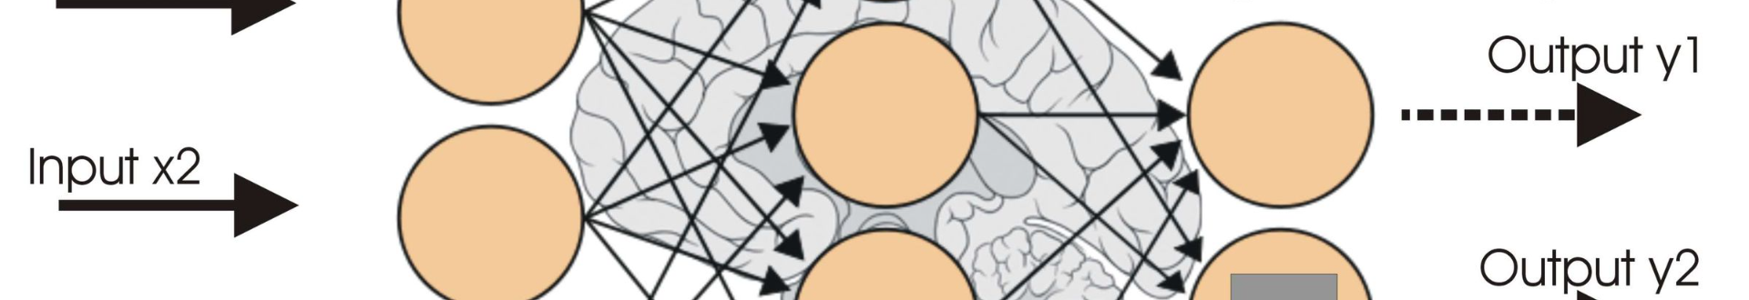
Splitting the Data into Training and Testing Sets
Selecting Data: The first step in preparing data for machine learning involves selecting the data that will be used for training and testing. This includes ensuring that the datasets are representative and balanced, and that they have the appropriate features for the machine learning model.
Training Set: After the data is selected, a portion of it is allocated to the training set. This set is used to train the machine learning model, allowing it to learn and adjust its parameters based on the input data and the expected outputs.
Testing Set: The remaining data is then allocated to the testing set. This set is used to evaluate the performance of the trained model on new, unseen data. It helps in assessing the model's generalization ability and its performance on real-world data.

Slide 25
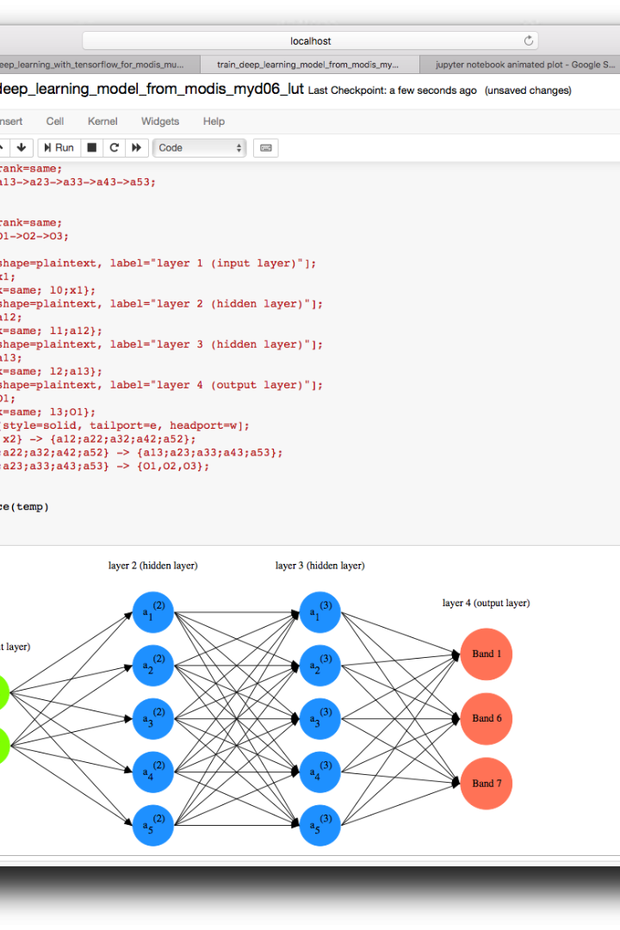
Building machine learning models in Python
Python is widely used in the field of machine learning due to its simplicity and powerful libraries such as NumPy, Pandas, Matplotlib, and Scikit-learn. In this section, we will explore the process of building machine learning models in Python, including data preprocessing, model training, evaluation, and deployment.

